Slide 1
Interactive Graphics
Eric Roberts
CS 106A
January 27, 2010

Slide 2
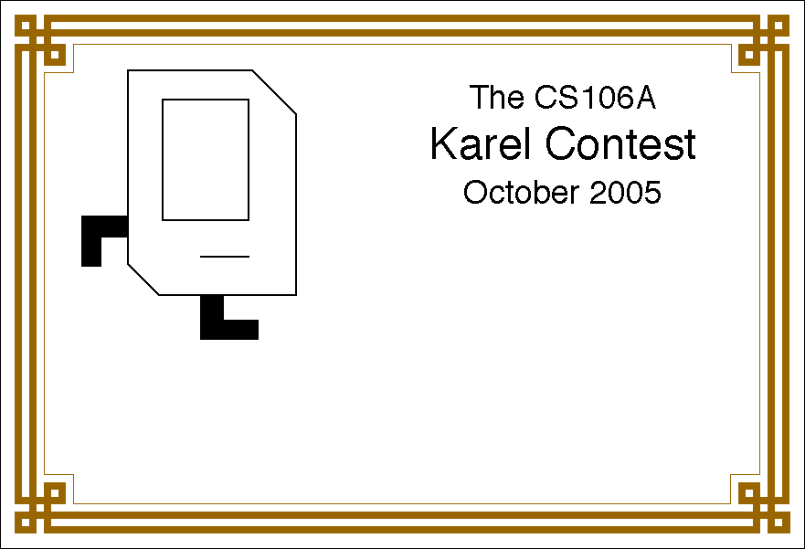
Karel Contest Results
The CS106A
Karel Contest
January 2010

Slide 3
Karel Contest Results
First place (algorithmic):
Aubrey Shapero, Game of Life *
Runner-up (algorithmic):
Dustin Janatpour, KarelType2
Runner-up (algorithmic):
Will Monroe, MetaKarel
Runner-up (algorithmic):
Jonathan Rodriguez, Pong
First place (aesthetic):
Nicholas McGee, Frogger *
Runner-up (aesthetic):
Caroline Shen, City Landscape
Runner-up (aesthetic):
Dustin Janatpour, KarelType2
Runner-up (aesthetic):
Scott Parks, Pikachu
Honorable mention:
Nian Liu, Battlefield
Honorable mention:
Nicholas Baldo, Binary Karel
Honorable mention:
Jeff Lu, BlackJack
Honorable mention:
Mitchel Scott, Dreidel Karel
Honorable mention:
Travis Golia, Mini Golf
* Both winners would have been runners-up in the other category.

Slide 4




Class Standings
19/39
0.49
20/58
0.34
19/73
0.26
6/48
0.13
Freshman
Sophomore
Junior
Senior

Slide 5
Interactive Graphics

Slide 6
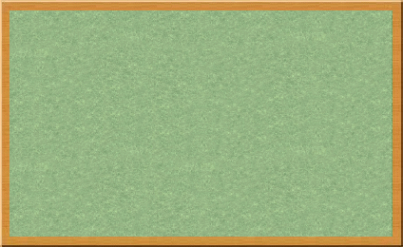
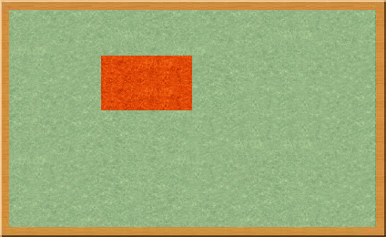
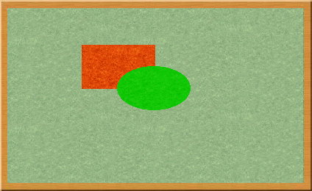
The acm.graphics Model
The acm.graphics package uses a collage model in which you create an image by adding various objects to a canvas.
A collage is similar to a child’s felt board that serves as a backdrop for colored shapes that stick to the felt surface. As an example, the following diagram illustrates the process of adding a red rectangle and a green oval to a felt board:
Note that newer objects can obscure those added earlier. This layering arrangement is called the stacking order.

Slide 7
Structure of the acm.graphics Package
The GObject class forms the root of the hierarchy of graphical objects. Anything you add to the canvas must be a GObject.
The classes at the bottom of the figure are the shape classes and indicate specific types of graphical objects that you can draw.
The remaining classes and interfaces are discussed in subsequent slides, either today or on Friday.
The following diagram shows the classes in the acm.graphics package and their relationship in the Java class hierarchy:
GCanvas
GPoint
GDimension
GRectangle
GMath
GTurtle
GCompound
GObject
GPen
GLabel
GRect
GOval
GLine
GArc
GImage
GPolygon
Interfaces:
GFillable
GResizable
GScalable
GContainer
GRoundRect
G3DRect

Slide 8
The GCanvas Class
The GCanvas class is used to represent the background canvas for the collage model and therefore serves as a virtual felt board. When you use the acm.graphics package, you create pictures by adding various GObjects to a GCanvas.
For simple applications, you won’t actually need to work with an explicit GCanvas object. Whenever you run a program that extends GraphicsProgram, the initialization process for the program automatically creates a GCanvas and resizes it so that it fills the program window.
Most of the methods defined for the GCanvas class are also available in a GraphicsProgram, thanks to an important strategy called forwarding. If, for example, you call the add method in a GraphicsProgram, the program passes that message along to the underlying GCanvas object by calling its add method with the same arguments.

Slide 9
Methods in the GCanvas Class
The following methods are available in both the GCanvas and GraphicsProgram classes:
add(object)
Adds the object to the canvas at the front of the stack
add(object, x, y)
Moves the object to (x, y) and then adds it to the canvas
remove(object)
Removes the object from the canvas
removeAll()
Removes all objects from the canvas
getElementAt(x, y)
Returns the frontmost object at (x, y), or null if none
getWidth()
Returns the width in pixels of the entire canvas
getHeight()
Returns the height in pixels of the entire canvas
setBackground(c)
Sets the background color of the canvas to c.
The following methods are available in GraphicsProgram only:
pause(milliseconds)
Pauses the program for the specified time in milliseconds
waitForClick()
Suspends the program until the user clicks the mouse

Slide 10
The Two Forms of the add Method
The add method comes in two forms. The first is simply
add(object);
which adds the object at the location currently stored in its internal structure. You use this form when you have already set the coordinates of the object, which usually happens at the time you create it.
The second form is
add(object, x, y);
which first moves the object to the point (x, y) and then adds it there. This form is useful when you need to determine some property of the object before you know where to put it. If, for example, you want to center a GLabel, you must first create it and then use its size to determine its location.

Slide 11
Methods Common to All GObjects
setLocation(x, y)
Resets the location of the object to the specified point
move(dx, dy)
Moves the object dx and dy pixels from its current position
movePolar(r, theta)
Moves the object r pixel units in direction theta
getX()
Returns the x coordinate of the object
getY()
Returns the y coordinate of the object
getWidth()
Returns the horizontal width of the object in pixels
getHeight()
Returns the vertical height of the object in pixels
contains(x, y)
Returns true if the object contains the specified point
setColor(c)
Sets the color of the object to the Color c
getColor()
Returns the color currently assigned to the object
setVisible( flag)
Sets the visibility flag (false = invisible, true = visible)
isVisible()
Returns true if the object is visible
sendToFront()
Sends the object to the front of the stacking order
sendToBack()
Sends the object to the back of the stacking order
sendForward()
Sends the object forward one position in the stacking order
sendBackward()
Sends the object backward one position in the stacking order

Slide 12
Sharing Behavior through Interfaces
In addition to the methods defined for all GObjects shown on the preceding slide, there are a few methods that apply to some GObject subclasses but not others. You already know, for example, that you can call setFilled on either a GOval or a GRect. At the same time, it doesn’t make sense to call setFilled on a GLine because there is no interior to fill.
In Java, the best strategy when you have methods that apply to some subclasses but not others is to define an interface that specifies the shared methods. An interface definition is similar to a class definition except that the interface omits the implementation of each method, retaining only the header line that shows the types of each argument.
In the acm.graphics package, there are three interfaces that define methods for certain GObject subclasses: GFillable, GResizable, and GScalable. The methods in these interfaces appear on the next slide.

Slide 13
Methods Defined by Interfaces
GFillable (GArc, GOval, GPolygon, GRect)
setFilled( flag)
Sets the fill state for the object (false = outlined, true = filled)
isFilled()
Returns the fill state for the object
setFillColor(c)
Sets the color used to fill the interior of the object to c
getFillColor()
Returns the fill color
GResizable (GImage, GOval, GRect)
setSize(width, height)
Sets the dimensions of the object as specified
setBounds(x, y, width, height)
Sets the location and dimensions together
GScalable (GArc, GCompound, GLine, GImage, GOval, GPolygon, GRect)
scale(sf )
Scales both dimensions of the object by sf
scale(sx, sy)
Scales the object by sx horizontally and sy vertically

Slide 14
Using the Shape Classes
The shape classes are the GObject subclasses that appear in yellow at the bottom of the hierarchy diagram.
GObject
GLabel
GRect
GOval
GLine
GArc
GImage
GPolygon
GRoundRect
G3DRect
Each of the shape classes corresponds precisely to a method in the Graphics class in the java.awt package. Once you have learned to use the shape classes, you will easily be able to transfer that knowledge to Java’s standard graphics tools.
skip ahead to animation

Slide 15
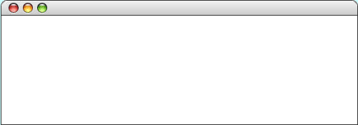
The GLabel Class
You’ve been using the GLabel class ever since Chapter 2 and already know how to change the font and color, as shown in the most recent version of the “Hello World” program:
public class HelloProgram extends GraphicsProgram {
public void run() {
GLabel label = new GLabel("hello, world", 100, 75);
label.setFont("SansSerif-36");
label.setColor(Color.RED);
add(label);
}
}
HelloProgram
hello, world

Slide 16
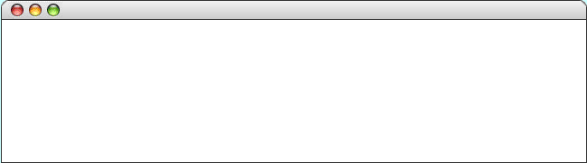
The Geometry of the GLabel Class
The GLabel class relies on a set of geometrical concepts that are derived from classical typesetting:
  The baseline is the imaginary line on which the characters rest.
  The origin is the point on the baseline at which the label begins.
  The height of the font is the distance between successive baselines.
  The ascent is the distance characters rise above the baseline.
  The descent is the distance characters drop below the baseline.
You can use the getHeight, getAscent, and getDescent methods to determine the corresponding property of the font. You can use the getWidth method to determine the width of the entire label, which depends on both the font and the text.
QuickBrownFox
origin
The quick brown fox jumps
over the lazy dog.
ascent
height
baseline
descent

Slide 17
The GRect Class
The GRect class implements the GFillable, GResizable, and GScalable interfaces but does not otherwise extend the facilities of GObject.
Like every other shape class, the GRect constructor comes in two forms. The first includes both the location and the size:
new GRect(x, y, width, height)
This form makes sense when you know in advance where the rectangle belongs.
The second constructor defers setting the location:
new GRect(width, height)
This form is more convenient when you want to create a rectangle and then decide where to put it later.

Slide 18
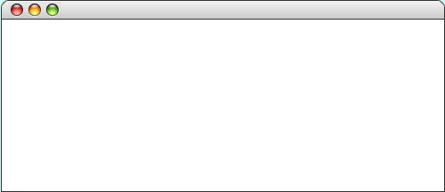
GRoundRect and G3DRect
As the class hierarchy diagram indicates, the GRect class has two subclasses. In keeping with the rules of inheritance, any instance of GRoundRect or G3DRect is also a GRect and inherits its behavior.
GRect
GRoundRect
G3DRect
The sample run at the bottom of the screen shows what happens if you execute the following calls:
add(new GRoundRect(100, 60, 75, 50));
add(new G3DRect(300, 60, 75, 50));
RoundAnd3DRect

Slide 19
The GOval Class
The GOval class represents an elliptical shape defined by the boundaries of its enclosing rectangle.
As an example, the following run method creates the largest oval that fits within the canvas:
public void run() {
GOval oval = new GOval(getWidth(), getHeight());
oval.setFilled(true);
oval.setColor(Color.GREEN);
add(oval, 0, 0);
}
LargestOval

Slide 20
The GLine Class
The GLine class represents a line segment that connects two points. The constructor call looks like this:
new GLine(x₀, y₀, x₁, y₁)
The points (x₀, y₀) and (x₁, y₁) are called the start point and the end point, respectively.
The GLine class does not support filling or resizing but does implement the GScalable interface. When you scale a line, its start point remains fixed.
Given a GLine object, you can get the coordinates of the two points by calling getStartPoint and getEndPoint. Both of these methods return a GPoint object.
The GLine class also exports the methods setStartPoint and setEndPoint, which are illustrated on the next slide.

Slide 21
Setting Points in a GLine
The following run method illustrates the difference between the setLocation method (which moves both points together) and setStartPoint/setEndPoint (which move only one):
public void run() {
GLine line = new GLine(0, 0, 100, 100);
add(line);
line.setLocation(200, 50);
line.setStartPoint(200, 150);
line.setEndPoint(300, 50);
}
public void run() {
GLine line = new GLine(0, 0, 100, 100);
add(line);
line.setLocation(200, 50);
line.setStartPoint(200, 150);
line.setEndPoint(300, 50);
}
LineGeometryExample

Slide 22
The Java Event Model
Graphical applications usually make it possible for the user to control the action of a program by using an input device such as a mouse. Programs that support this kind of user control are called interactive programs.
User actions such as clicking the mouse are called events. Programs that respond to events are said to be event-driven.
In modern interactive programs, user input doesn’t occur at predictable times. A running program doesn’t tell the user when to click the mouse. The user decides when to click the mouse, and the program responds. Because events are not controlled by the program, they are said to be asynchronous.
When you write a Java program, you indicate the events to which you wish to respond by designating some object as a listener for that event. When the event occurs, a message is sent to the listener, which triggers the appropriate response.

Slide 23
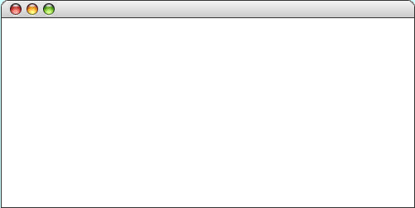

The Role of Event Listeners
One way to visualize the role of a listener is to imagine that you have access to one of Fred and George Weasley’s “Extendable Ears” from the Harry Potter series.
Suppose that you wanted to use these magical listeners to detect events in the canvas shown at the bottom of the slide. All you need to do is send those ears into the room where, being magical, they can keep you informed on anything that goes on there, making it possible for you to respond.
ListenerExample

Slide 24
Responding to Mouse Events
On a more practical level, the process of making a program respond to mouse events requires the following steps:
1. Define an init method that calls addMouseListeners.
2. Write new definitions of any listener methods you need.
The most common mouse events are shown in the following table, along with the name of the appropriate listener method:
mouseClicked( e)
Called when the user clicks the mouse
mousePressed( e)
Called when the mouse button is pressed
mouseReleased(e)
Called when the mouse button is released
mouseMoved(e)
Called when the user moves the mouse
mouseDragged(e)
Called when the mouse is dragged with the button down
The parameter e is a MouseEvent object, which gives more data about the event, such as the location of the mouse.

Slide 25
A Simple Line-Drawing Program
Drawing a line using this program requires three actions: pressing the mouse button at the starting point of the line, dragging the mouse to the desired end point, and then releasing the mouse.
The mousePressed method responds to that event by creating a new zero-length line that begins and ends at the current mouse position.
Dragging the mouse results in a series of mouseDragged calls that come in rapid succession each time the computer reads the mouse position. Each call simply resets the end point of the line.
The effect of this strategy is that the user sees the line as it grows, providing the necessary visual feedback to position the line correctly.
As you drag the mouse, the line will stretch, contract, and change direction as if the two points were connected by an elastic band. This technique is therefore called rubber-banding.
In all likelihood, you have at some point used an application that allows you to draw lines with the mouse. In Java, that program takes less than a page of code.
public class DrawLines extends GraphicsProgram {
/* Initializes the program by enabling the mouse listeners */
public void init() {
addMouseListeners();
}
/* Called on mouse press to create a new line */
public void mousePressed(MouseEvent e) {
line = new GLine(e.getX(), e.getY(), e.getX(), e.getY());
add(line);
}
/* Called on mouse drag to extend the endpoint */
public void mouseDragged(MouseEvent e) {
line.setEndPoint(e.getX(), e.getY());
}
/* Private instance variables */
private GLine line;
}
public class DrawLines extends GraphicsProgram {
/* Initializes the program by enabling the mouse listeners */
public void init() {
addMouseListeners();
}
/* Called on mouse press to create a new line */
public void mousePressed(MouseEvent e) {
line = new GLine(e.getX(), e.getY(), e.getX(), e.getY());
add(line);
}
/* Called on mouse drag to extend the endpoint */
public void mouseDragged(MouseEvent e) {
line.setEndPoint(e.getX(), e.getY());
}
/* Private instance variables */
private GLine line;
}

Slide 26
Simulating the DrawLines Program
– The addMouseListeners call in init enables mouse events.
– Depressing the mouse button generates a mouse pressed event.
– The mousePressed call adds a zero-length line to the canvas.
– Dragging the mouse generates a series of mouse dragged events.
– Each mouseDragged call extends the line to the new position.
– Releasing the mouse stops the dragging operation.
– Repeating these steps adds new lines to the canvas.
DrawLines
DrawLines
mouse
pressed
mouse
dragged
mouse
dragged
mouse
dragged
mouse
dragged
mouse
dragged
mouse
dragged
mouse
dragged

Slide 27
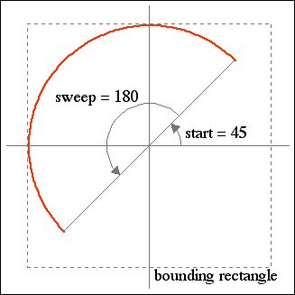
The GArc Class
The GArc class represents an arc formed by taking a section from the perimeter of an oval.
Conceptually, the steps necessary to define an arc are:
  Specify the coordinates and size of the bounding rectangle.
  Specify the start angle, which is the angle at which the arc begins.
  Specify the sweep angle, which indicates how far the arc extends.
The geometry used by the GArc class is shown in the diagram on the right.
In keeping with Java’s graphics model, angles are measured in degrees starting at the +x axis (the 3:00 o’clock position) and increasing counterclockwise.
Negative values for the start and sweep angles signify a clockwise direction.

Slide 28
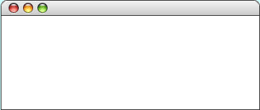
Exercise: GArc Geometry
Suppose that the variables cx and cy contain the coordinates of the center of the window and that the variable d is 0.8 times the screen height. Sketch the arcs that result from each of the following code sequences:
GArc a1 = new GArc(d, d, 0, 90);
add(a1, cx - d / 2, cy - d / 2);
GArc a2 = new GArc(d, d, 45, 270);
add(a2, cx - d / 2, cy - d / 2);
GArcExamples
GArcExamples
GArc a3 = new GArc(d, d, -90, 45);
add(a3, cx - d / 2, cy - d / 2);
GArc a4 = new GArc(d, d, 0, -180);
add(a4, cx - d / 2, cy - d / 2);
GArcExamples
GArcExamples

Slide 29
Filled Arcs
The GArc class implements the GFillable interface, which means that you can call setFilled on a GArc object.
A filled GArc is displayed as the pie-shaped wedge formed by the center and the endpoints of the arc, as illustrated below:
public void run() {
GArc arc = new GArc(0, 0, getWidth(), getHeight(),
0, 90);
arc.setFilled(true);
add(arc);
}
FilledEllipticalArc

Slide 30
The GImage Class
The GImage class is used to display an image from a file. The constructor has the form
new GImage(image file, x, y)
where image file is the name of a file containing a stored image and x and y are the coordinates of the upper left corner of the image.
When Java executes the constructor, it looks for the file in the current directory and then in a subdirectory named images.
To make sure that your programs will run on a wide variety of platforms, it is best to use one of the most common image formats: the Graphical Interchange Format (GIF), the Joint Photographic Experts Group (JPEG) format, or the Portable Network Graphics (PNG) format. Image files using these formats typically have the suffixes .gif, .jpg, and .png.

Slide 31
Images and Copyrights
Most images that you find on the web are protected by copyright under international law.
Before you use a copyrighted image, you should make sure that you have the necessary permissions. For images that appear of the web, the hosting site often specifies what rules apply for the use of that image. For example, images from the www.nasa.gov site can be used freely as long as you include the following citation identifying the source:
Courtesy NASA/JPL-Caltech
In some cases, noncommercial use of an image may fall under the “fair use” doctrine, which allows some uses of proprietary material. Even in those cases, however, academic integrity and common courtesy both demand that you cite the source of any material that you have obtained from others.

Slide 32

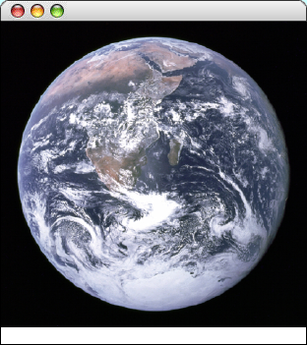
Example of the GImage Class
public void run() {
add(new GImage("EarthFromApollo17.jpg"));
addCitation("Courtesy NASA/JPL-Caltech");
}
public void run() {
add(new GImage("EarthFromApollo17.jpg"));
addCitation("Courtesy NASA/JPL-Caltech");
}
private void addCitation(String text) {
GLabel label = new GLabel(text);
label.setFont(CITATION_FONT);
double x = getWidth() - label.getWidth();
double y = getHeight() - CITATION_MARGIN + label.getAscent();
add(label, x, y);
}
EarthImage
Courtesy NASA/JPL-Caltech

Slide 33
The End

